Slide 1

People Tracking System
A Project created by Sterling Michel

Slide 2
Project Description
Overview
The People Tracking System is a unique online contacting system that enable a person to store and plot their contacts in a map. It allows the user the opportunity to search, share contact and understand where in the world are their friends and family located.

Slide 3
Cool Features
Contact Search
User will have the ability to perform search.
Contact Map Display
User Will see their contact plotted on the map.
Contact Sharing
User will have ability to share the information as a contact file.
Contact Rating
User will have the chance to rate their contact flag it as family, business or friend.

Slide 4
Design Challenges
Integrating with Google OAuth
Integrating with Google Map limitation
Using plugin to help generate contact information
Choosing proper REST API backend programming language
Integrating with Google Gmail API

Slide 5

Technology
PROJECT MANAGEMENT
GITHUB
JIRA
VS Code
FRONTEND
Html/css
Jquery
Jquery-ui
Javascript
BACKEND
Nodejs
MeteorJs
mongodb

Slide 6
Technology - UTILITIES
Jquery-UI
Advantage
Jquery
HTML/CSS/Javascript
Advantage
Lightweight
Easy to edit
Improved semantics
Compatibility Across Devices
Advantage
Cross-Browser Compatibility
DOM Manipulation
Ease of use
Simplified Syntax
Better User Experience
Disadvantage
Abstraction Layer
ES6+ Features
Integration
Maintenance friendly
Theme mechanism
Browser support
Documentation
Disadvantage
Browser Compatibility
Lack of Security
Performance Impact
Overriding Styles
Maintenance Challenges.
Faster Page Speed
Limited Layout Control.
Can hinder your understanding
Plugins
Flexible styling and themes
Disadvantage
Can be a bit confusing
Lot of the DOM CSS manipulation
VS Code
Advantage
Jira
Github
Advantage
Easy to use and learn
Impressive web client
End-to-End secure over ssh or https
opensource and or pay account
Advantage
Multi users with collaboration, level access and information sharing
Easy to document project and coordinate tasks
Lots of reporting features with real-time communication
Customizable and has plugin integration
Simple CLI
Disadvantage
Cost a bit high to purchase
To many functions, could get lost
Versatility to use with such as editing and viewing markdown files
Speed with lightweight editor that starts as a basic text editor, making it faster and more responsive
Cost-effective for freelance developers and smaller teams
Easy Plugin Extension with including IntelliSense, debugging, Git integration, and a highly customizable interface
Development operations with development operations like debugging, task running, and version control.
Disadvantage
Require some advance knowledge
Pay account is higher than competitor
MongDB
Advantage
Python Flask With Async
Advantage
Non-blocking I/O
Fast Execution
Scalability
Large Ecosystem with active Community
Disadvantage
Not Ideal for CPU-Intensive Tasks
Unstable API
Cloud-based
Flexibility
Speed
Cost-effective
Scalability
Swagger Framework
Advantage
Real-time applications
Disadvantage
Pre-built packages
Mobile web-apps
Caching
Cross-Platform
Fast Development
Security Risks
Asynchronous Programming Model
Extensive documentation
Integrates with front-end frameworks
Supportive community
Easy to learn
Disadvantage
Data redundancy
Memory usage
Limited document size
No transactions
Not recommended for relational data

Slide 7
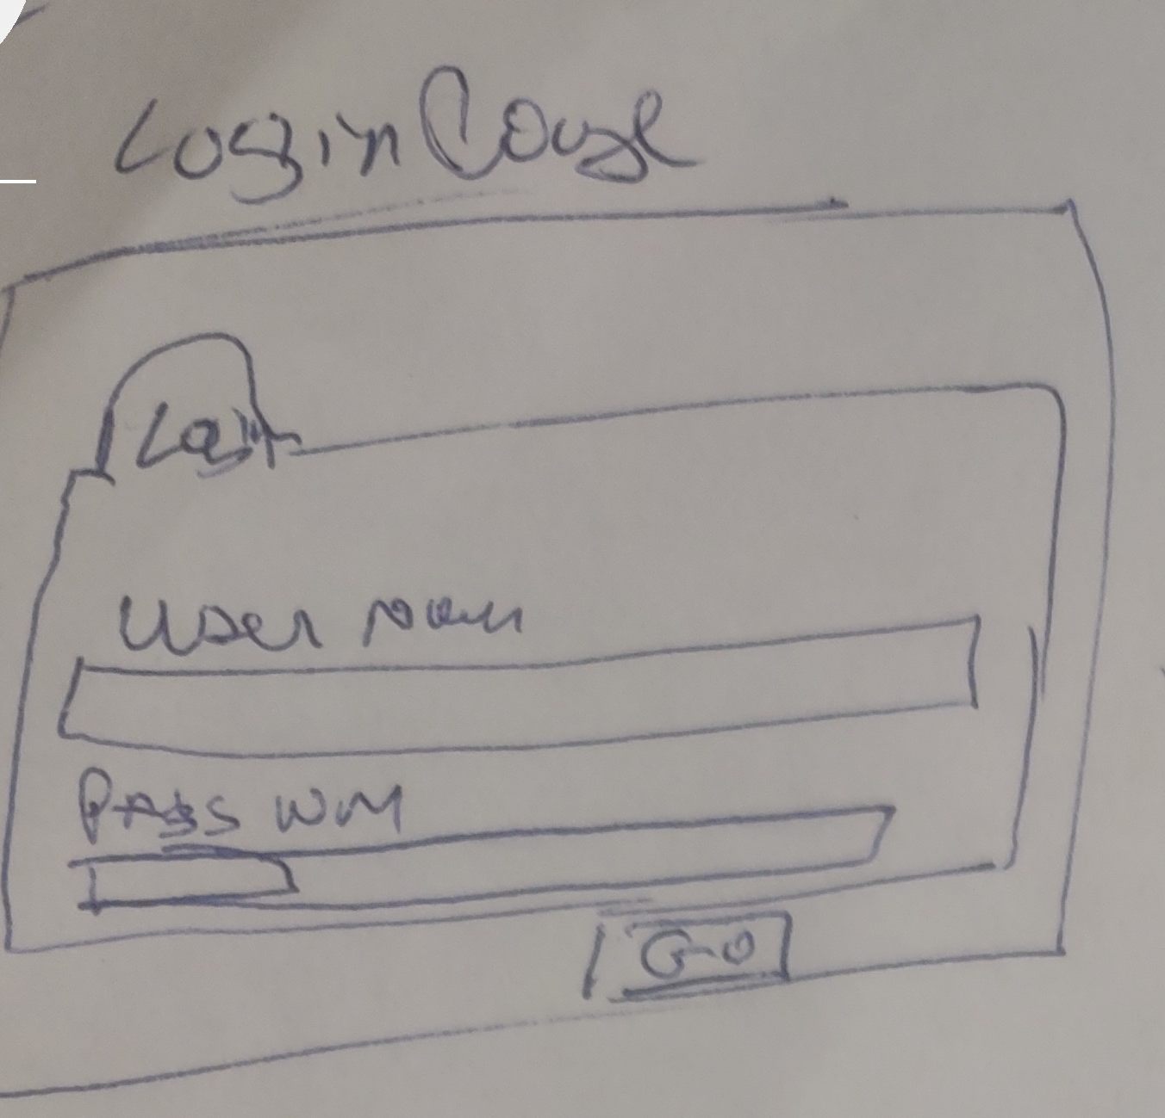
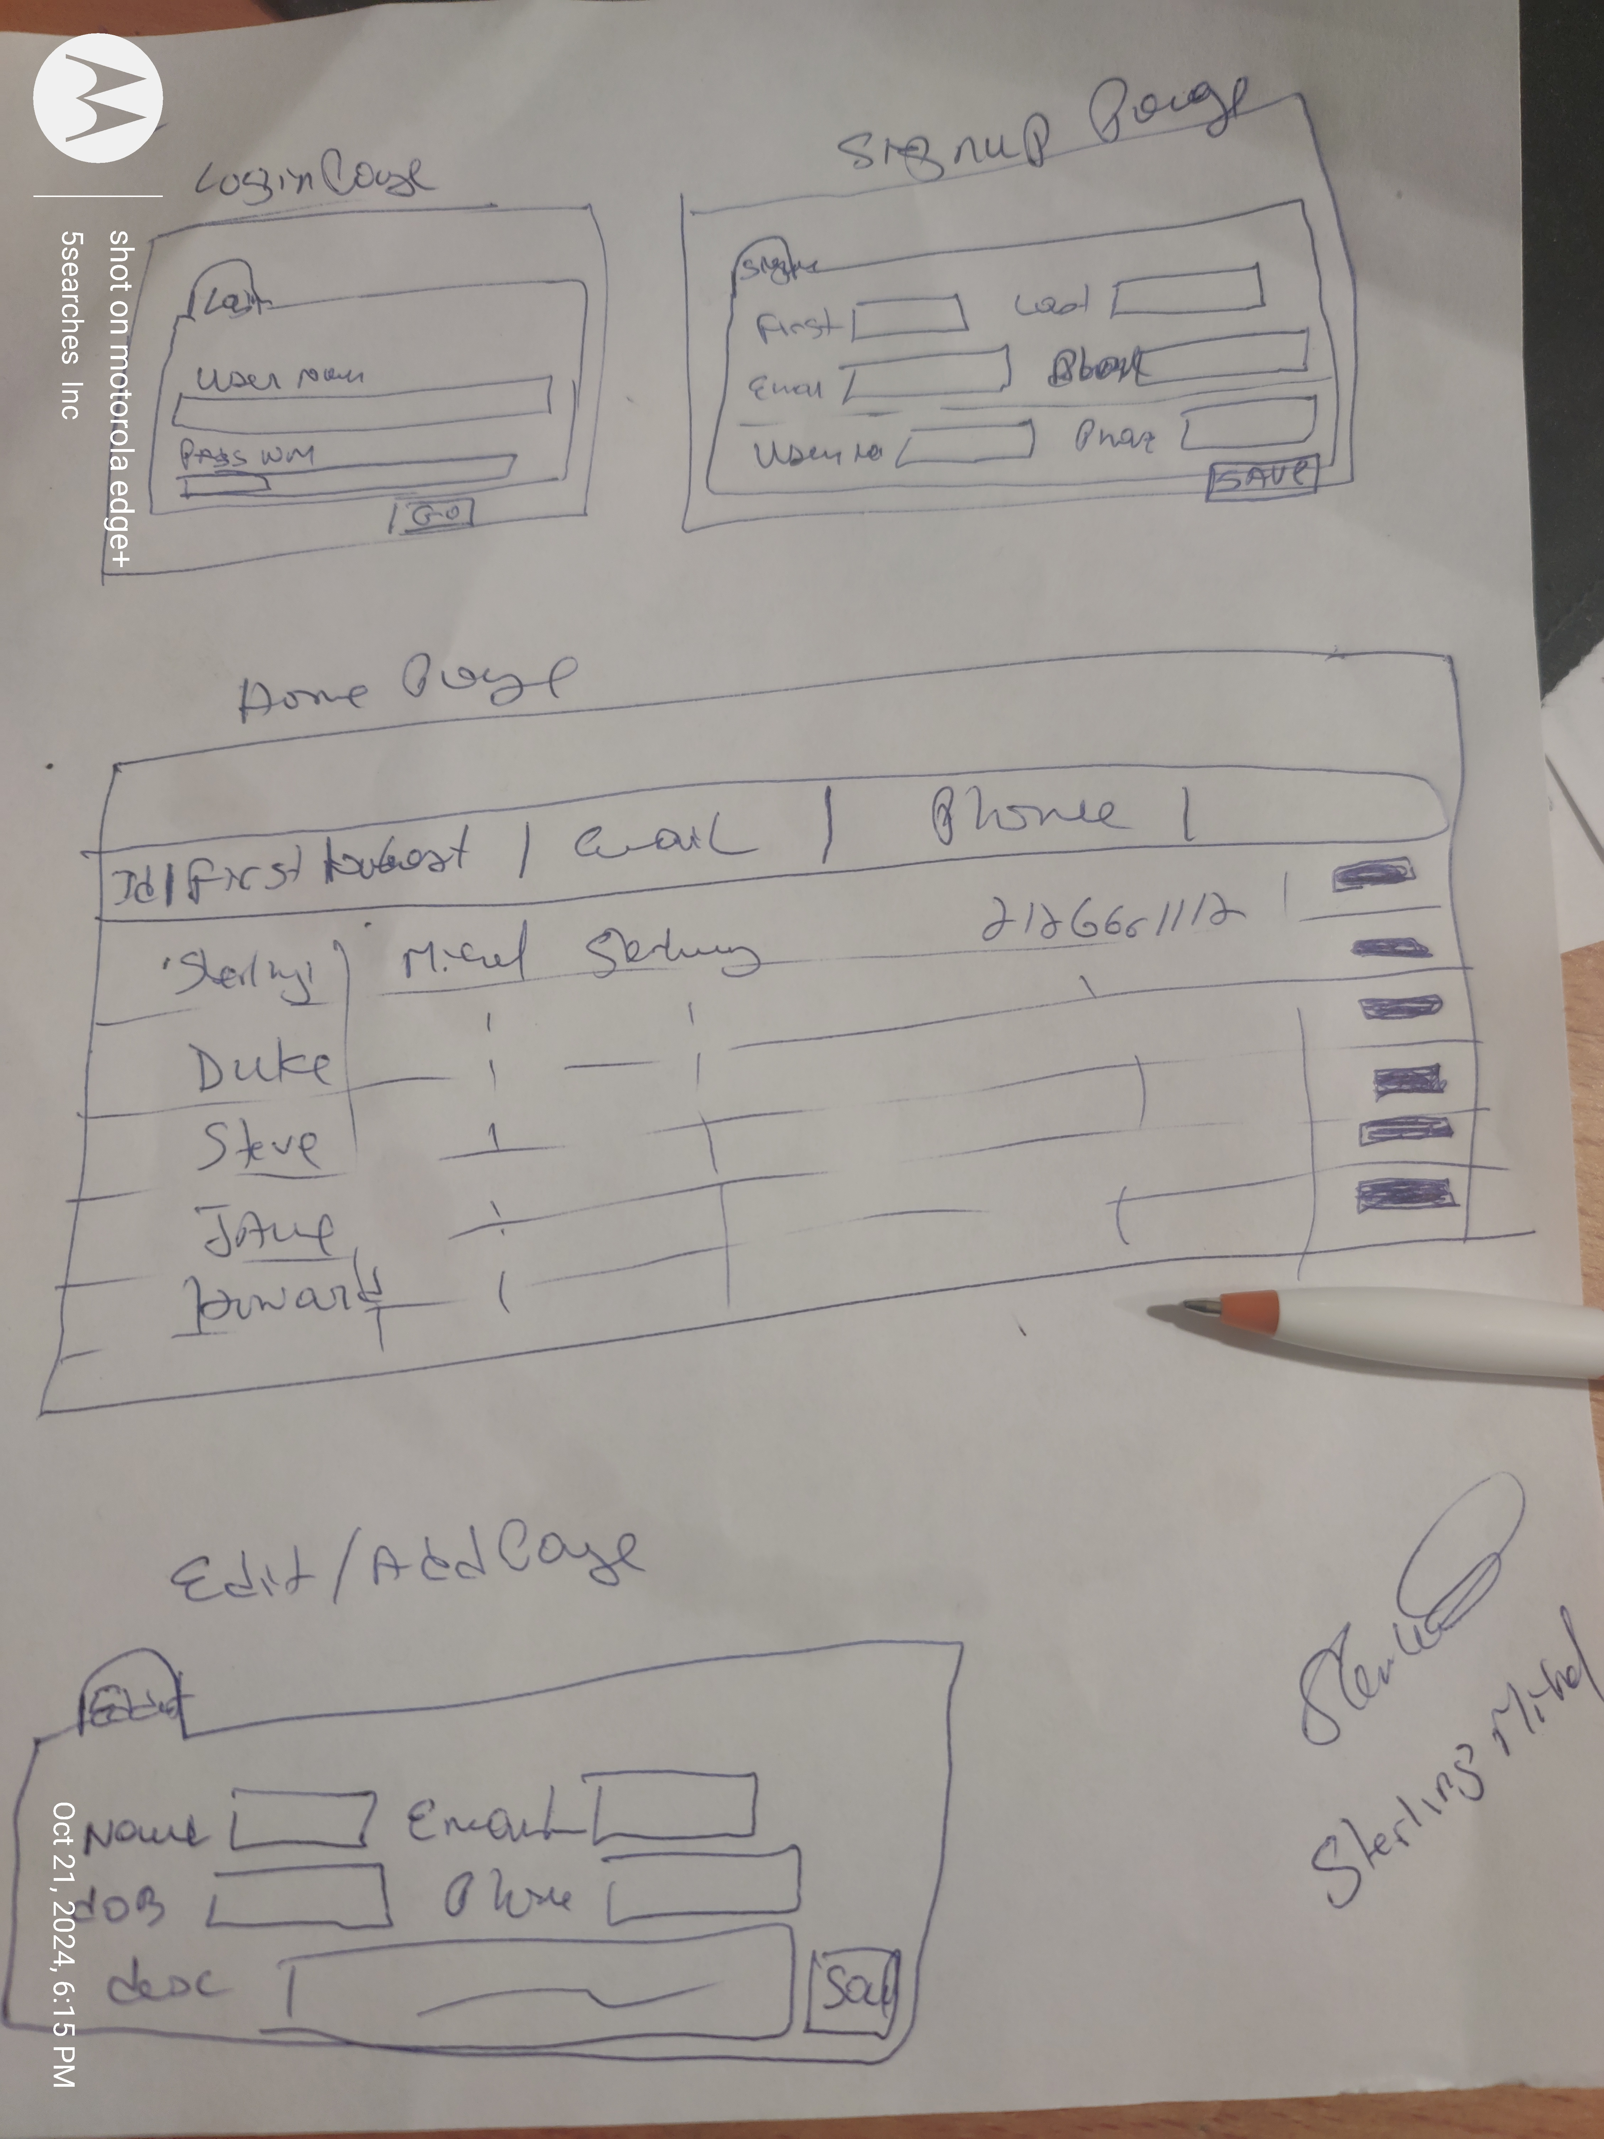
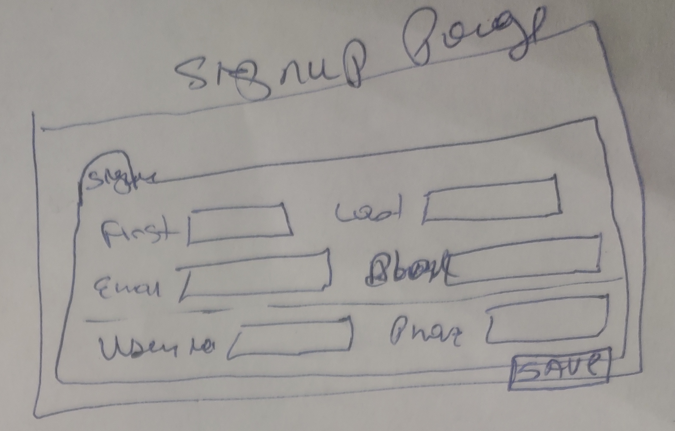
Technology - Design

Slide 8
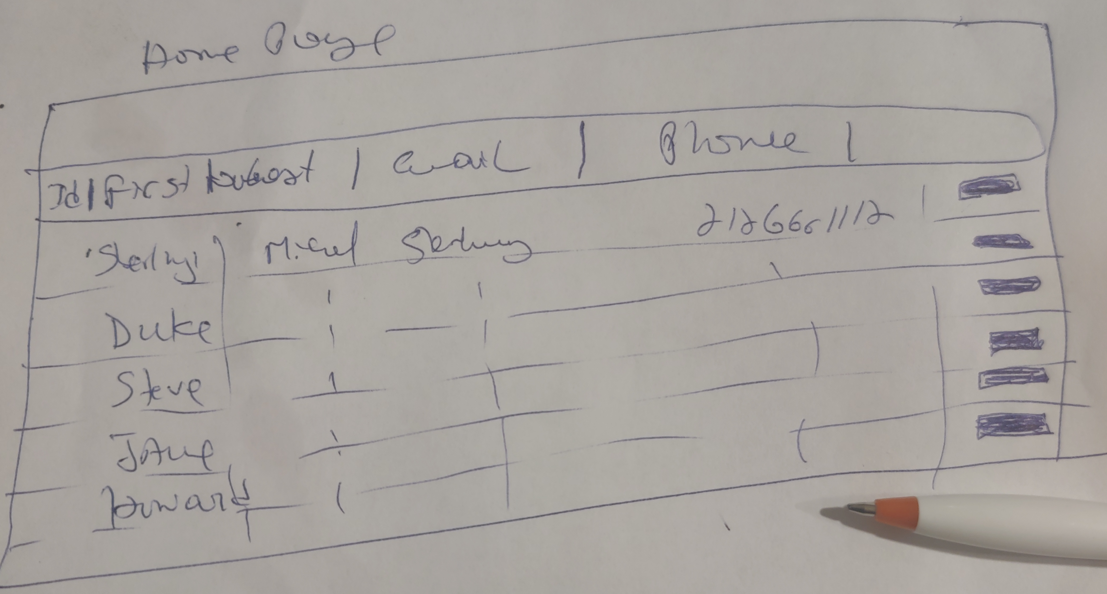
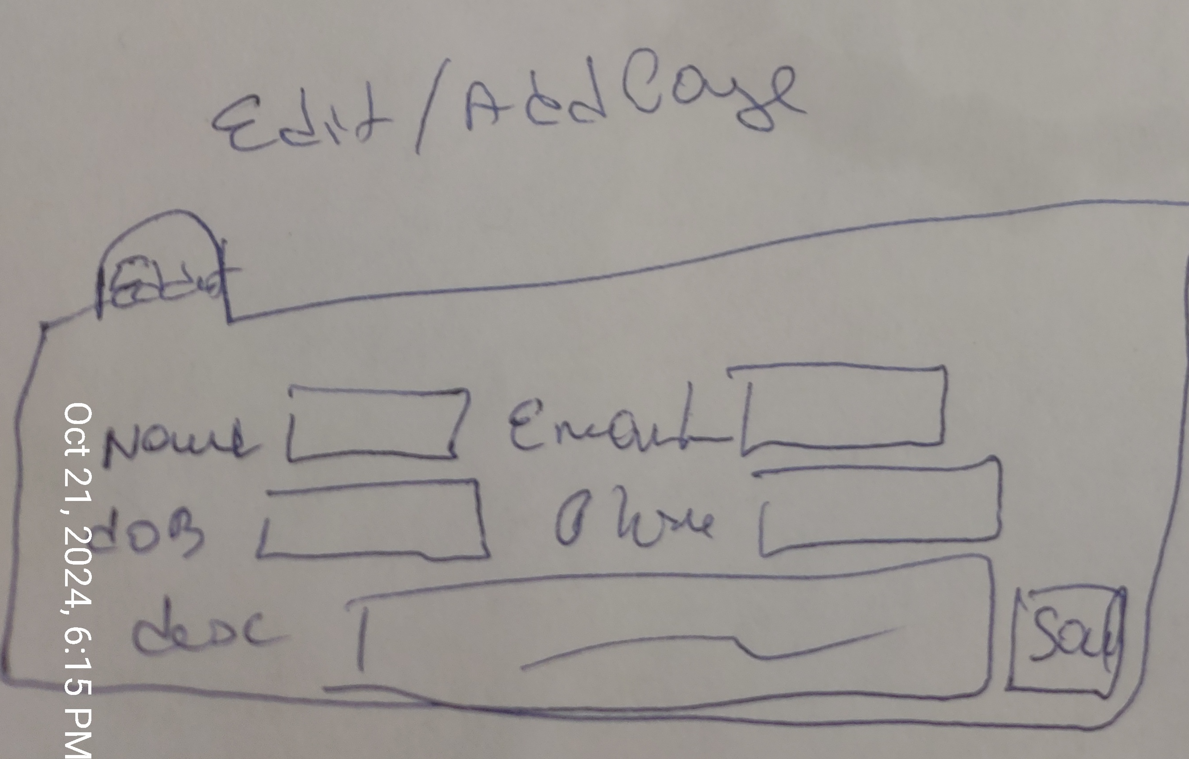
Technology – UI Design

Slide 9
Testing
Testing framework (Nodejs), using Mocha For frontend, (Python) using PyTestSuite for backend
Testing create into database
Testing delete into database
Testing Plotting location into UI webpage
Testing rest api endpoint

Slide 10

Documentation
Documentation created using Swagger API and manual entry
Important code sections given in-line comments to describe functionality

Slide 11

Project Presentation

